Slide 1
Fishing Simulator VR
Yuxiao Zou

Slide 2
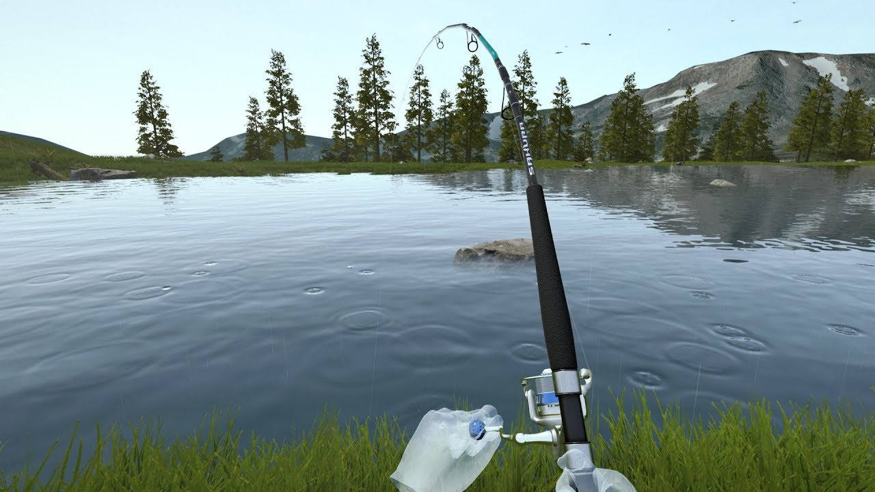
User Story
Jack wants to go fishing but it’s raining very heavily outside. And last time he went fishing, he didn’t get any fish because he’s just a beginner. This morning, he found a VR game called fishing simulator. He could now fish with a VR headset and controllers, cast virtual fishing rod, reel in fish, and explore different fishing locations, all while feeling like actually on a fishing trip.

Slide 3
User Needs
Player Control: Player needs motion controller compatibility because they want to move and see the surroundings.
Fishing: Player needs virtual fishing rod and reel mechanics because they want to simulate real fishing techniques and feel like they're actually casting and reeling in a fish.
Flexible Fishing Locations: Player needs multiple fishing locations because they want to explore different environments and have a variety of fishing experiences.
Variety of Fish Species: Player needs a variety of fish species because they want to catch different types of fish with unique characteristics, behaviors, and difficulty levels.
Fishing Equipment Upgrades: Player needs fishing equipment upgrades because they want to improve their chances of catching bigger or rarer fish, and feel a sense of progression and accomplishment.

Slide 4
User Journey
Change location and fish species
Walk
Home
Fish
Sell fish
Upgrade equipment

Slide 5
The Experience
The game offers a realistic and immersive fishing experience, simulating real fishing techniques.
The upgrading system will motivate players to keep playing and improving their skills.
Different locations will let players keep exploring the world and finding different fish species.
The one thing that players will remember when they leave is the sense of accomplishment and satisfaction that comes from catching fish, the beautiful environment and relaxing atmosphere.

